Slide 1
Maintain-X Equipment

Slide 2
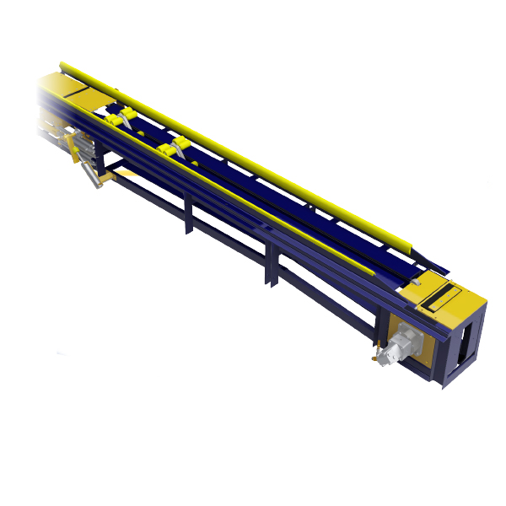
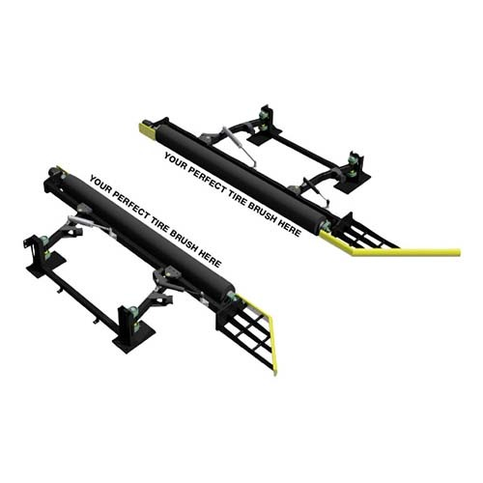
Conveyor
Brand Name
Length
Hydraulic or Electric
Chain Type
Sub-Assets
Hydraulic/Electric Motor
Gearbox
Sprocket
Soft Drop
Trap Door
Chain/Rollers
Drum
Drum Bearings
Roller Fork
Roller Up Cylinder
Carriage Cylinder
Carriage
UHMW Bushings
Rubber Stops
UHMW Chain Guides
UHMW Guides

Slide 3
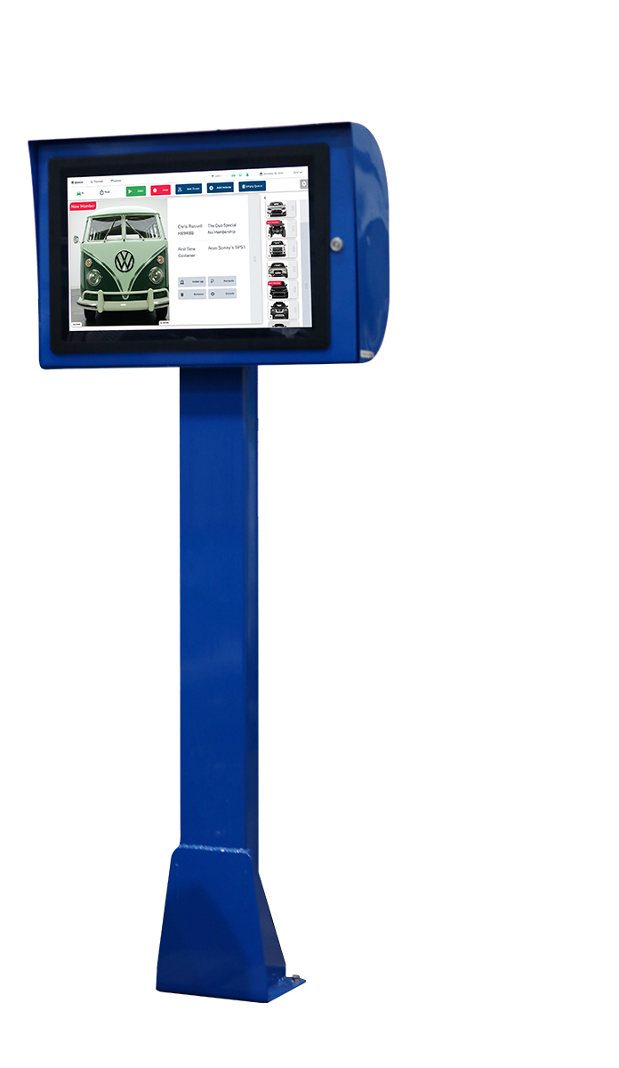
Touch Screen
Brand Name
Sub-Assets
Screen
Power Supply

Slide 4
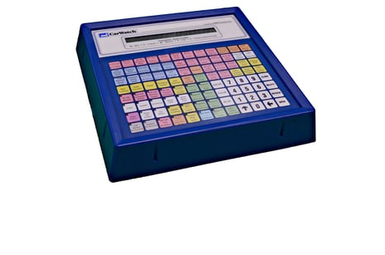
Keypad/Push Button
Brand Name
Sub-Assets
Power Supply

Slide 5
Tire Brush PS/DS
Brand Name
Hydraulic or Electric
Sub-Assets
Hydraulic/Electric Motor
Spindle Bearings
Brush Material
Pivot Bearings
Shocks
Cylinders
UHMW Guards
Bump Stops

Slide 6
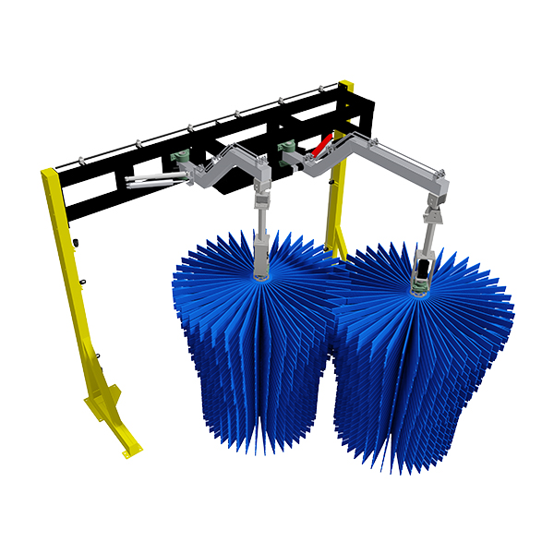
Wraps DS/PS
Brand Name
Electric or Hydraulic
Sub-Assets
Wrap Material
Hydraulic/Electric Motor
Gear Box
Pivot Bearings
Spindle Bearings
Shocks
Cylinders

Slide 7
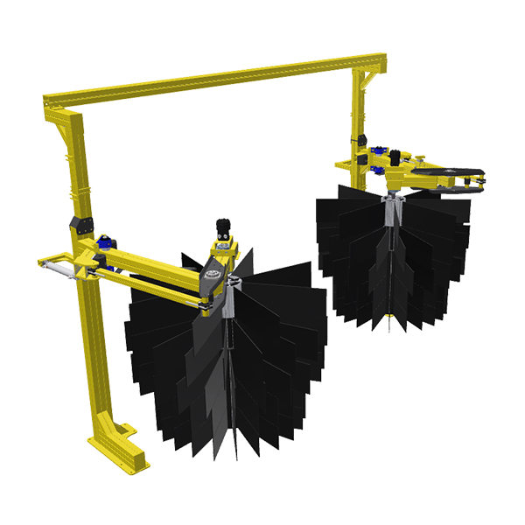
Grill Brush DS/PS
Brand Name
Electric or Hydraulic
Sub-Assets
Wrap Material
Hydraulic/Electric Motor
Gear Box
Pivot Bearings
Spindle Bearings
Shocks
Cylinders

Slide 8
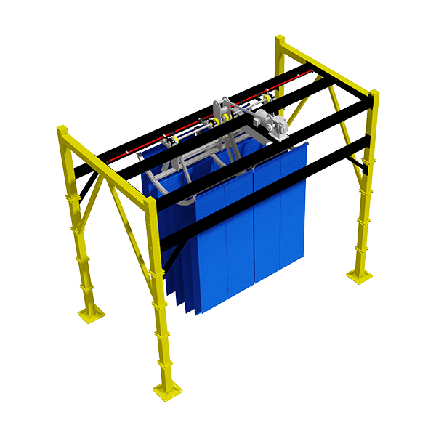
Mitter Front To Back
Brand Name
Electric or Hydraulic
Sub-Assets
Mitter Material
Hydraulic/Electric Motor
Gear Box
UHMW Bushings
Heim Joints

Slide 9
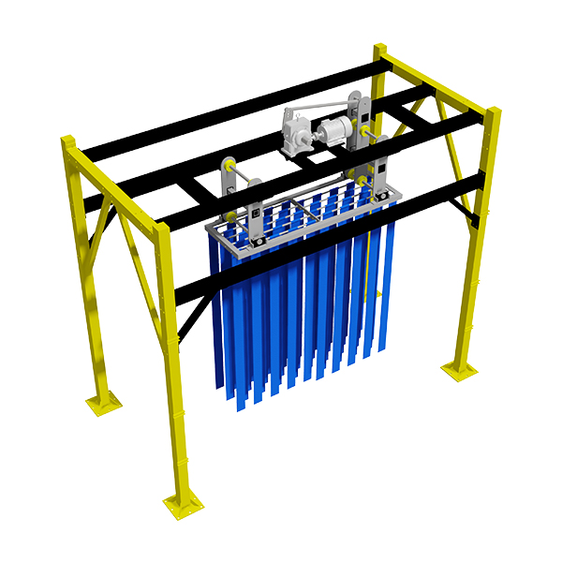
Mitter Side To Side
Brand Name
Electric or Hydraulic
Sub-Assets
Mitter Material
Hydraulic/Electric Motor
Gear Box
UHMW Bushings
Heim Joints

Slide 10
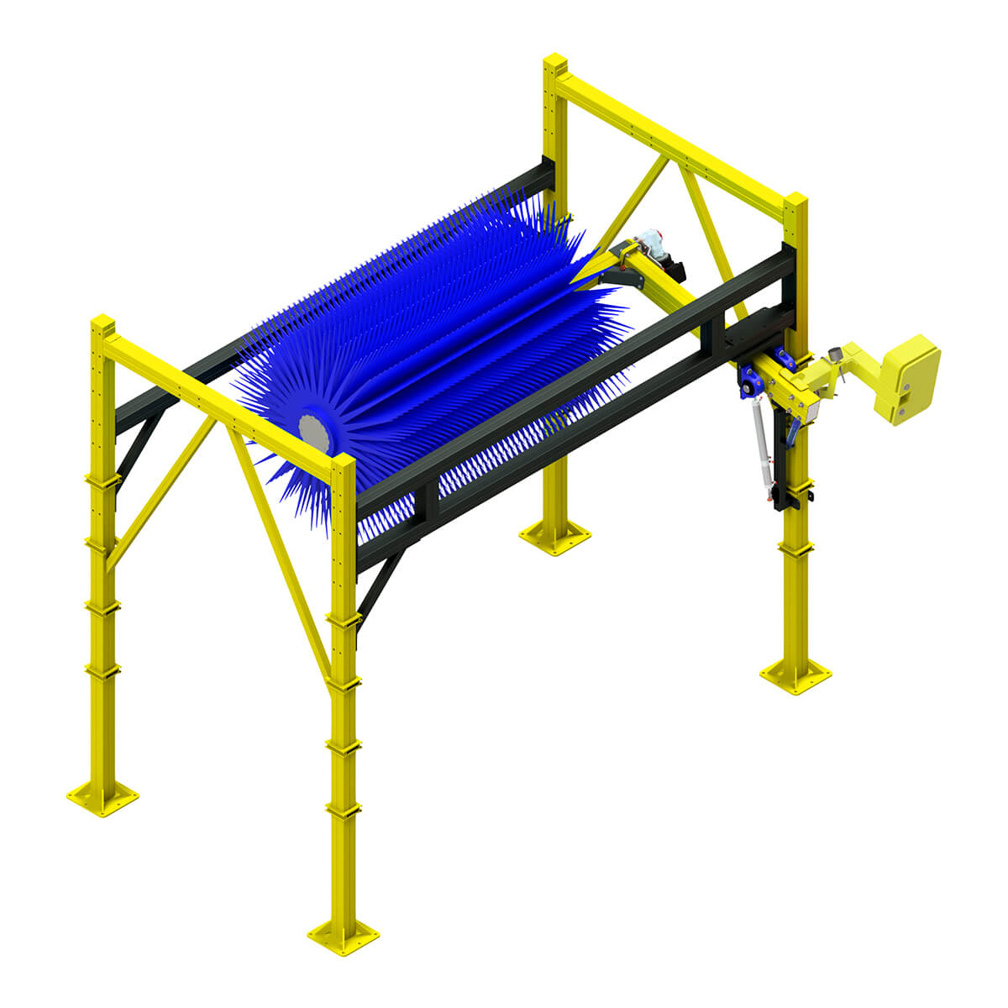
Top Brush Compact
Brand Name
Electric or Hydraulic
Sub-Assets
Brush Material
Hydraulic/Electric Motor
Gear Box
Pivot Bearings
Spindle Bearings
Shocks
Cylinders

Slide 11
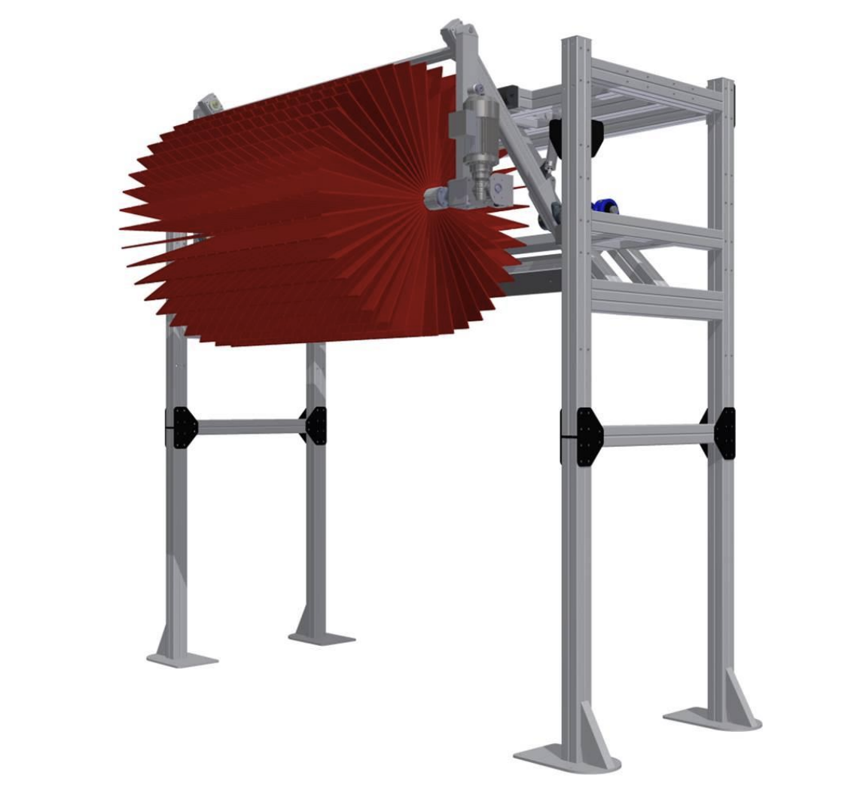
Top Brush Dual Action
Brand Name
Electric or Hydraulic
Sub-Assets
Brush Material
Hydraulic/Electric Motor
Gear Box
Pivot Bearings
Spindle Bearings
Shocks
Cylinders
Heim Joints

Slide 12
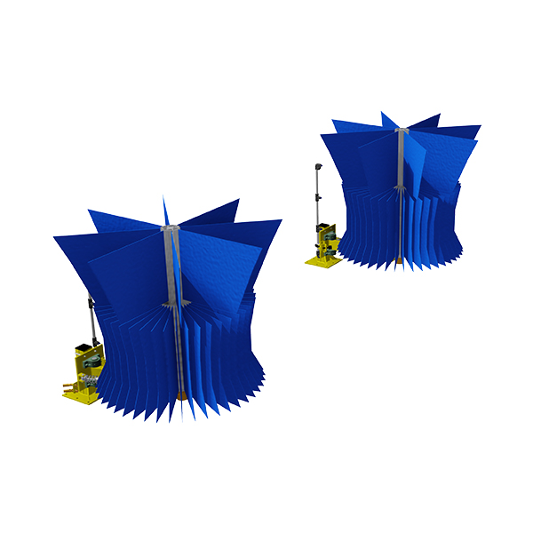
Rockers DS/PS
Brand Name
Electric or Hydraulic
Sub-Assets
Brush Material
Hydraulic/Electric Motor
Gear Box
Pivot Bearings
Spindle Bearings
Shocks

Slide 13
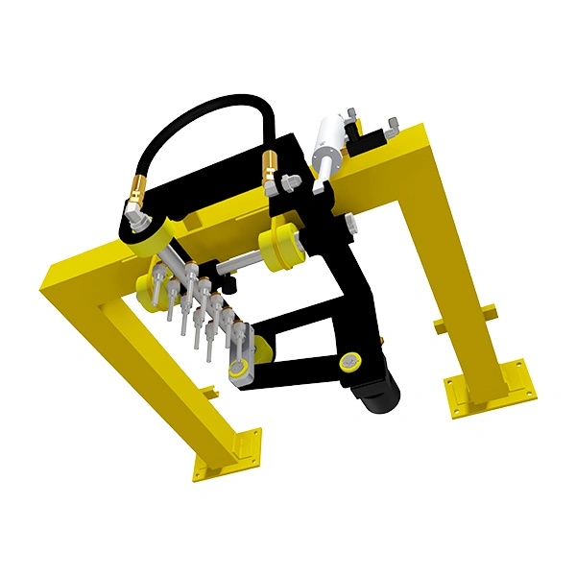
Omni-Top Blast
Brand Name
Electric or Hydraulic
Sub-Assets
Hydraulic/Electric Motor
Gear Box
UHMW Bushings
Cylinders
Nozzles

Slide 14
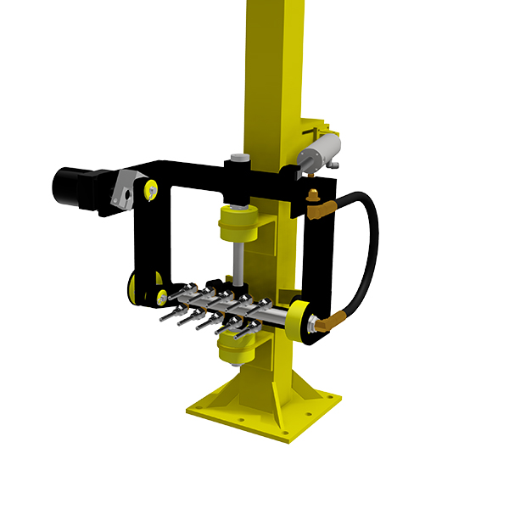
Omni-Side PS/DS
Brand Name
Electric or Hydraulic
Sub-Assets
Hydraulic/Electric Motor
Gear Box
UHMW Bushings
Cylinders
Nozzles

Slide 15
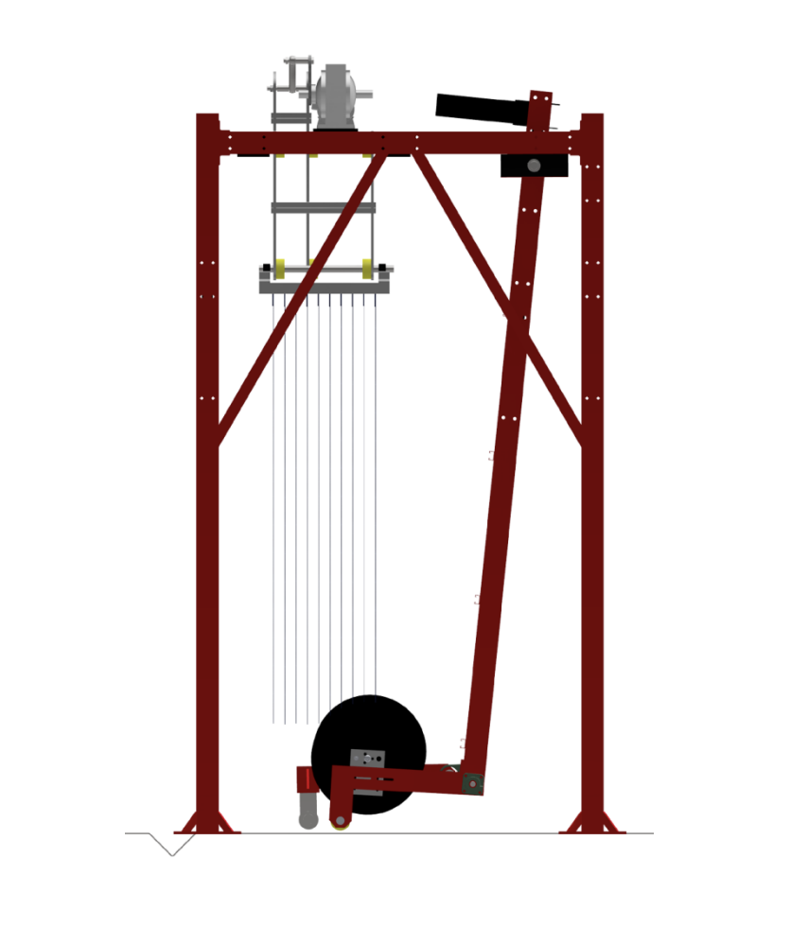
Omni-Pendulum PS/DS
Brand Name
Pneumatically or Physically Actuated
Sub-Assets
UHMW Bushings
Cylinders
Nozzles
Swivel Joint

Slide 16
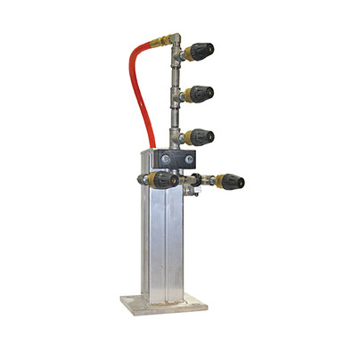
Omni-Turbo PS/DS
Brand Name
Sub-Assets
UHMW Bushings
Cylinders
Turbo Nozzles

Slide 17
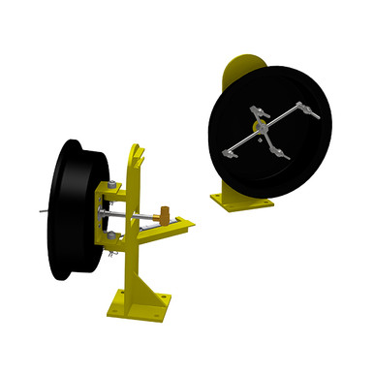
Omni-Wheel Blaster PS/DS
Brand Name
Sub-Assets
UHMW Bushings
Cylinders
Nozzles
Swivel Joint

Slide 18
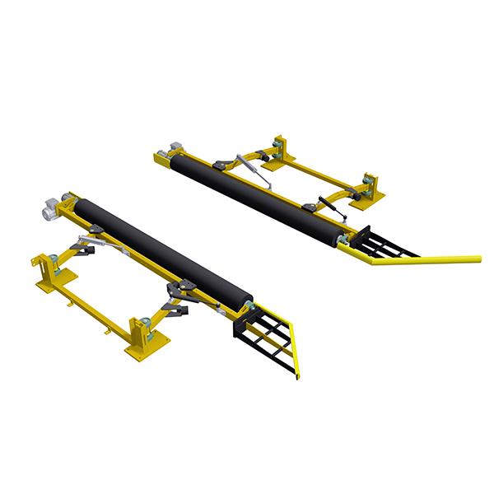
Tire Shine PS/DS
Brand Name
Hydraulic or Electric
Sub-Assets
Hydraulic/Electric Motor
Spindle Bearings
Brush Material
Pivot Bearings
Shocks
Cylinders
UHMW Guards
Bump Stops
Tire Shine Manifolds

Slide 19
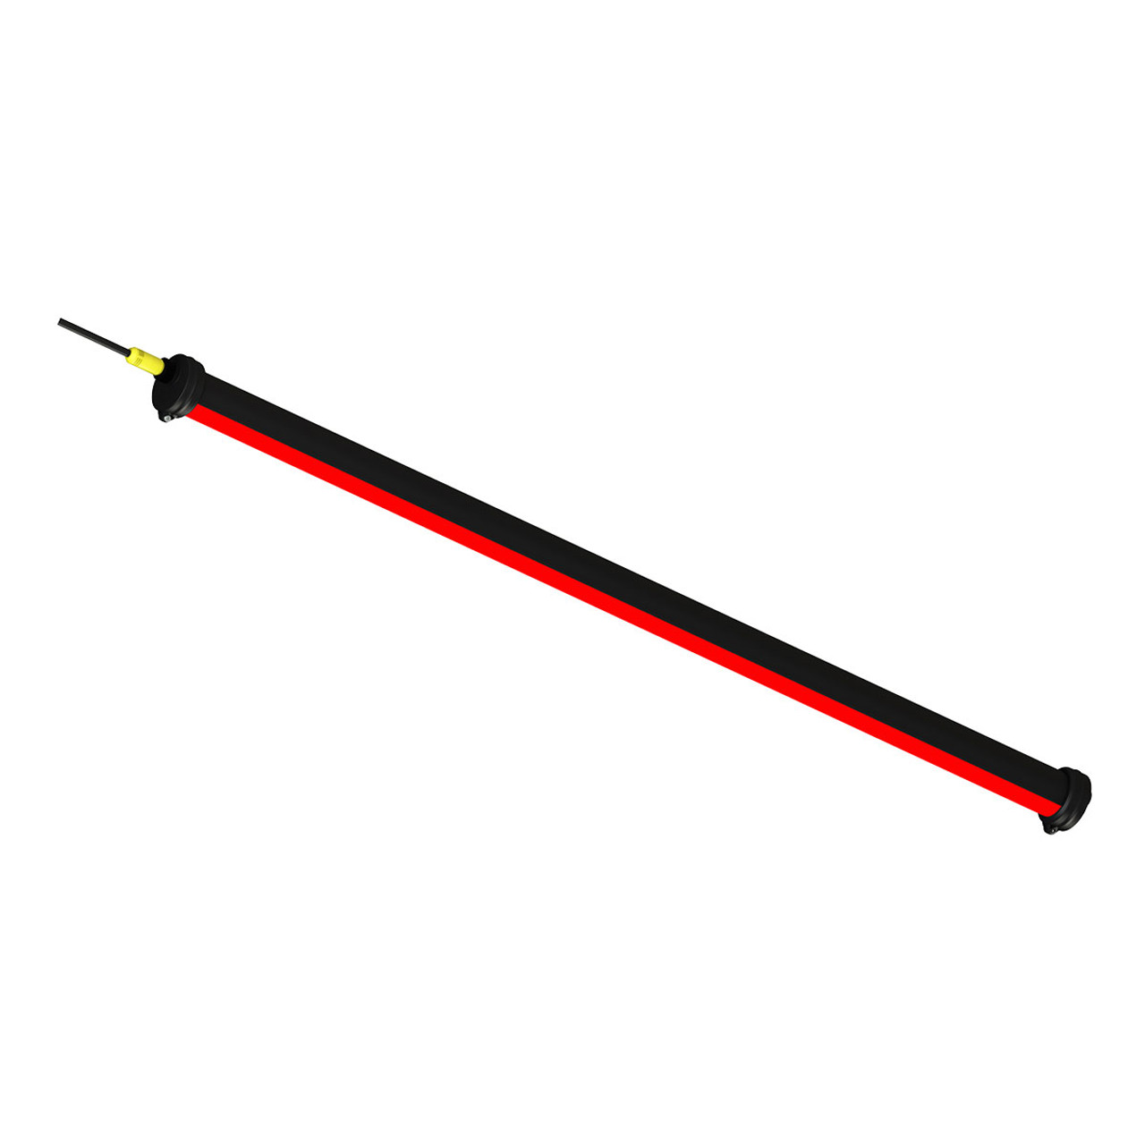
LEDs
Brand Name
Sub-Assets
Transformer

Slide 20
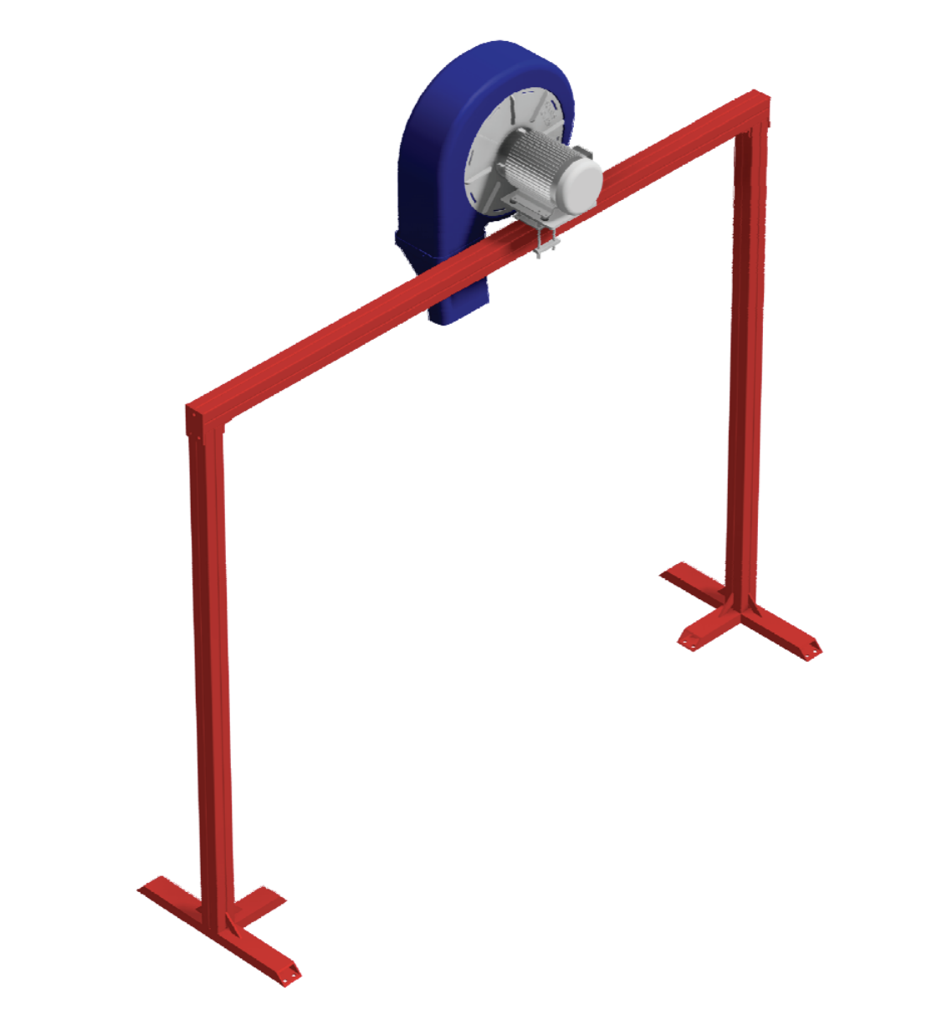
Blowers
Brand Name
Sub-Assets
Electric Motor
Impellor
Housing
Tips
Grill/Screen

Slide 21
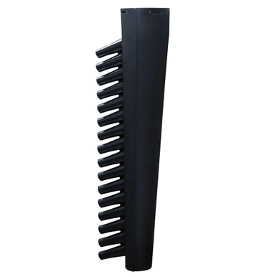
Mammoth DS/PS
Brand Name
Sub-Assets
Tips
Cylinders
UHMW Bushings

Slide 22
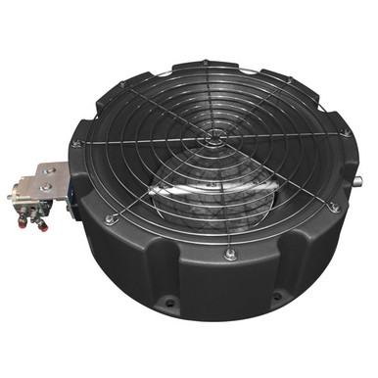
Gators
Brand Name
Sub-Assets
Grill/Screen
Actuator
UHMW Bushings

Slide 23
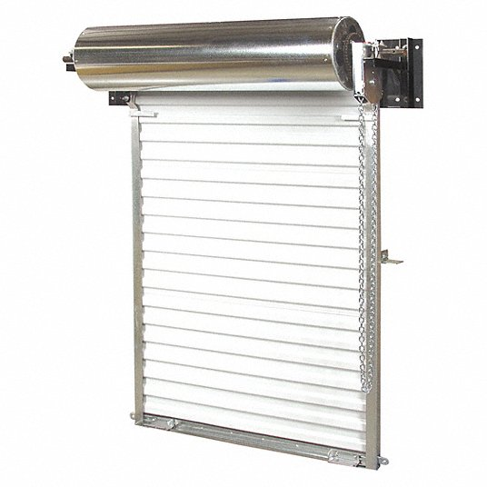
Garage Doors
Brand Name
Sub-Assets
Chain
Locks
Track

Slide 24
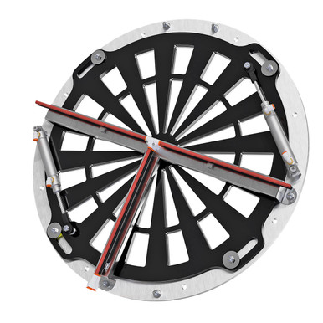
Star Gates
Brand Name
Sub-Assets
Grill/Screen
Cylinder
UHMW Bushings

Slide 25
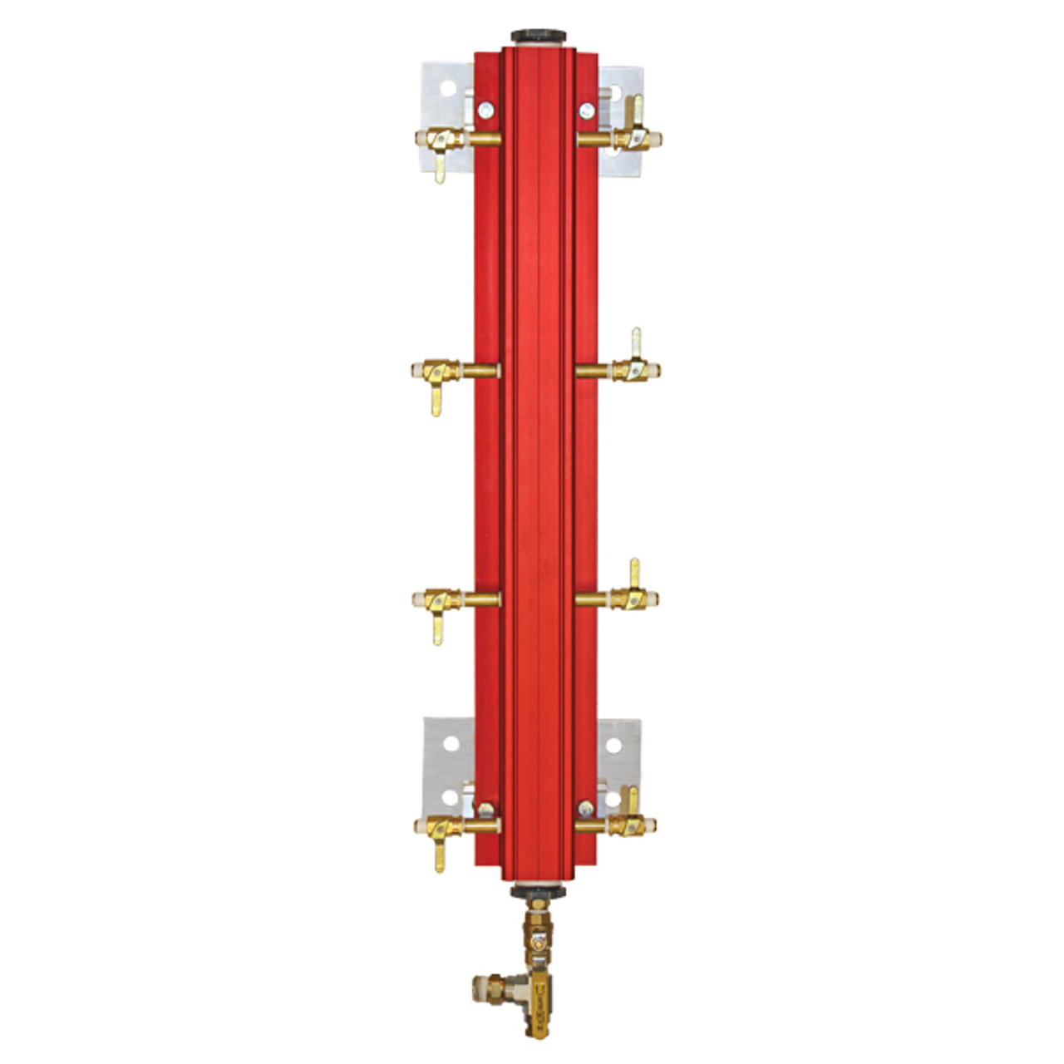
Air Manifold
Brand Name
Type – Tree or Air Link
Sub-Assets
MAC Valve
Regulators
Main Regulator/Dryer/Oiler
Power Distribution Block

Slide 26
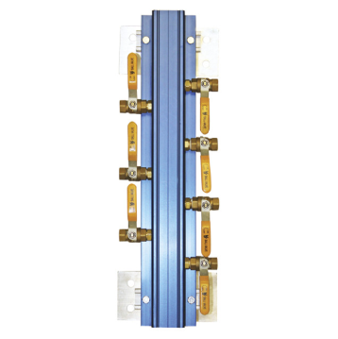
Water Manifold
Brand Name
Type – Tree or Water Link
Sub-Assets
Solenoids
Power Distribution Block

Slide 27
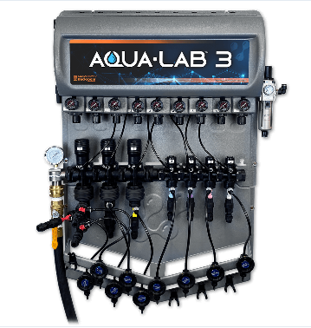
Chemical Board
Brand Name
Sub-Assets
Main Air Regulator
Air Regulator
Air Valve
Versa-Dial
Power Distribution Box
MAC Valve

Slide 28
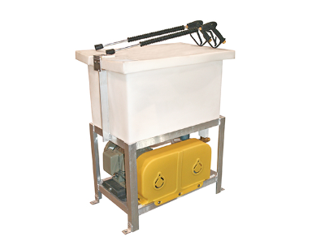
Prep Gun Unit
Brand Name
HP
Pump Brand
Sub-Assets
Electric Motor
Pump
Regulator
Belts
Float Valve

Slide 29
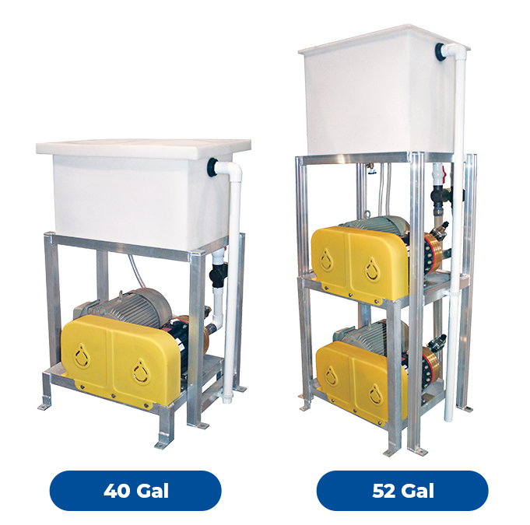
HP Omni-Type
Brand Name
HP
Sub-Assets
Electric Motor
Pump
Regulator
Belts
Float Valve
Reclaim Solenoids

Slide 30
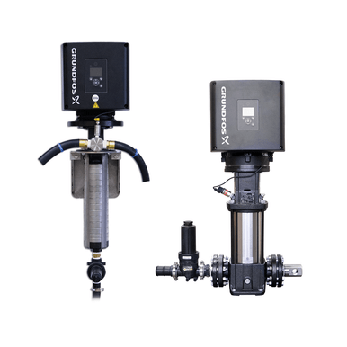
Booster Pump-Chemical
Brand Name
HP
Wall or Floor Mount
Sub-Assets
Transducer
Regulator
Motor Control Box

Slide 31
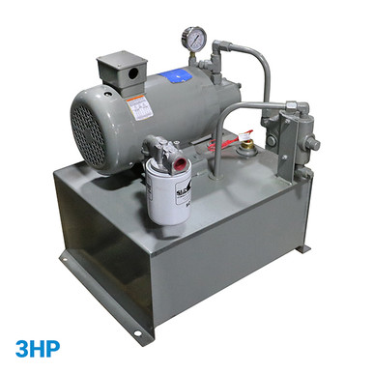
Power Pack-Type
Brand Name
HP
Main or Spare
Water or Oil Base
Sub-Assets
Electric Motor
Hydraulic Pump
Oil Filter
Proportion Valve
Low Level Switch

Slide 32
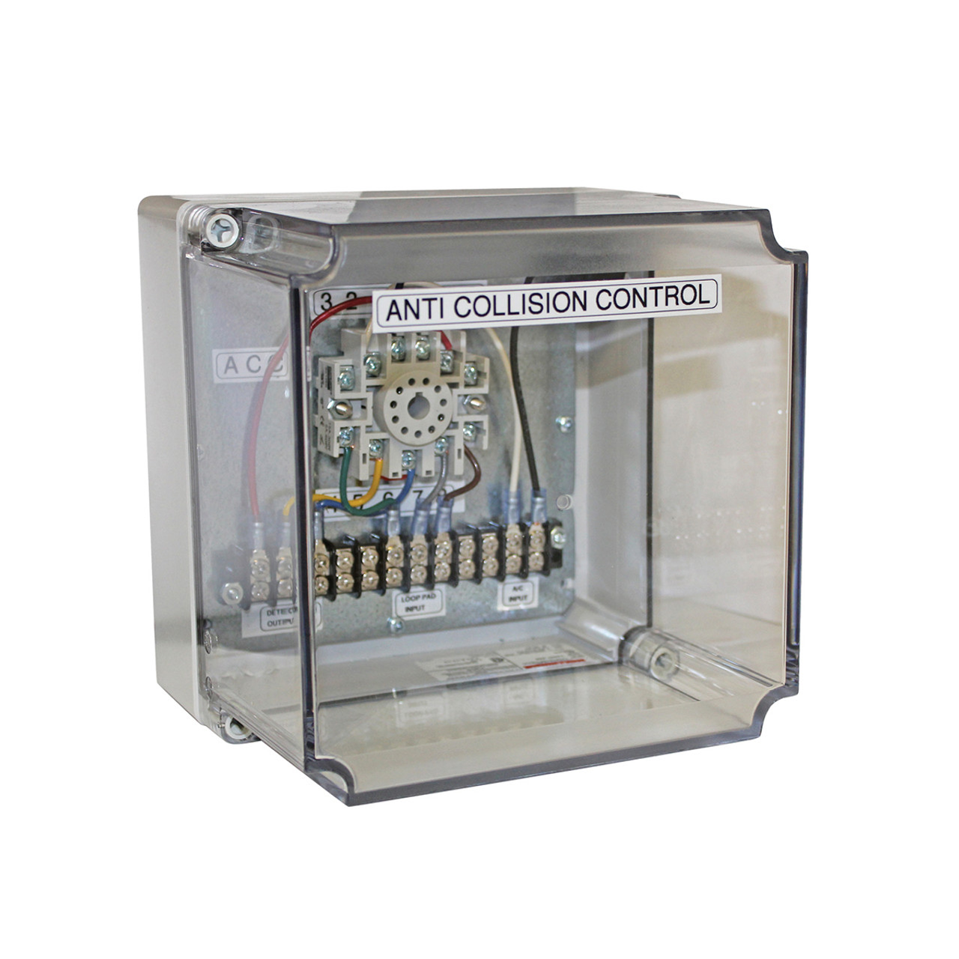
Anti Collison
Brand Name
Sub-Assets
Relay
EMX Pad

Slide 33
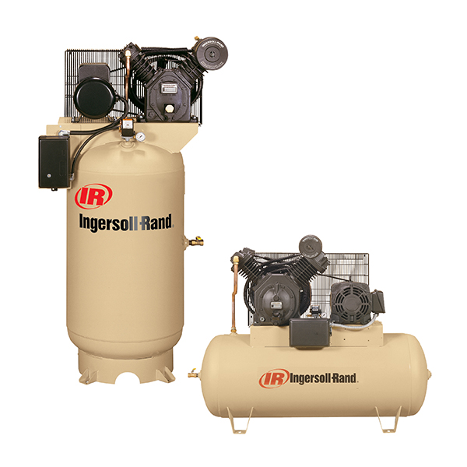
Air Compressors
Brand Name
HP
Screw or Reciprocating
Sub-Assets
Pump
Electric Motor
Pressure Switch
Air Filter
Low Level Switch
Contactor
Belts
Radiator
Auto-Drains
Regulator/Dryer/Oiler

Slide 34
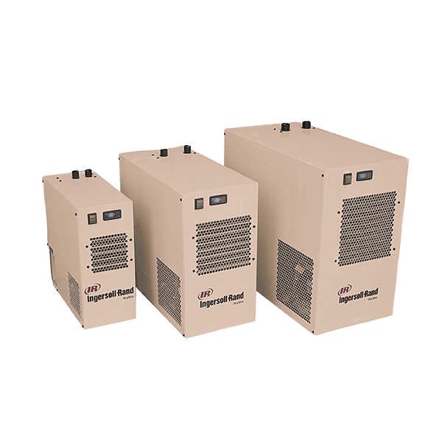
Air Dryer
Brand Name

Slide 35
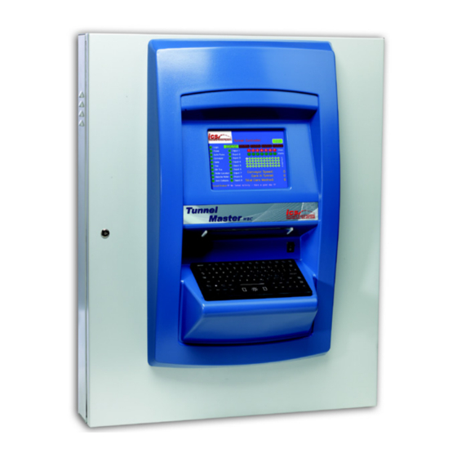
Controller
Brand Name
Type (WBC,TMJr,TCS)
Sub-Assets
Relays
Relay Board
Power Supply
Communication Board
Display/Touch Screen

Slide 36
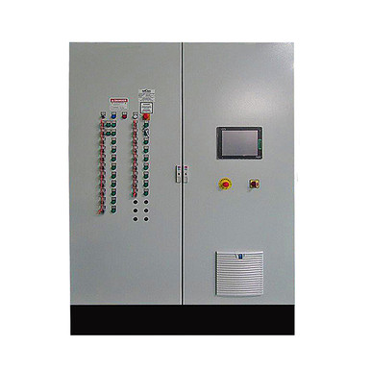
Controller
Brand Name
Job Number
Service Voltage (480,208)
Sub-Assets
MSP
Contactor
Timmer
VFD
Phase Monitor
Exhaust Fan
Door Switch
Touch Screen
Fuses
Transformer (24v,110v)
LED Indicator

Slide 37
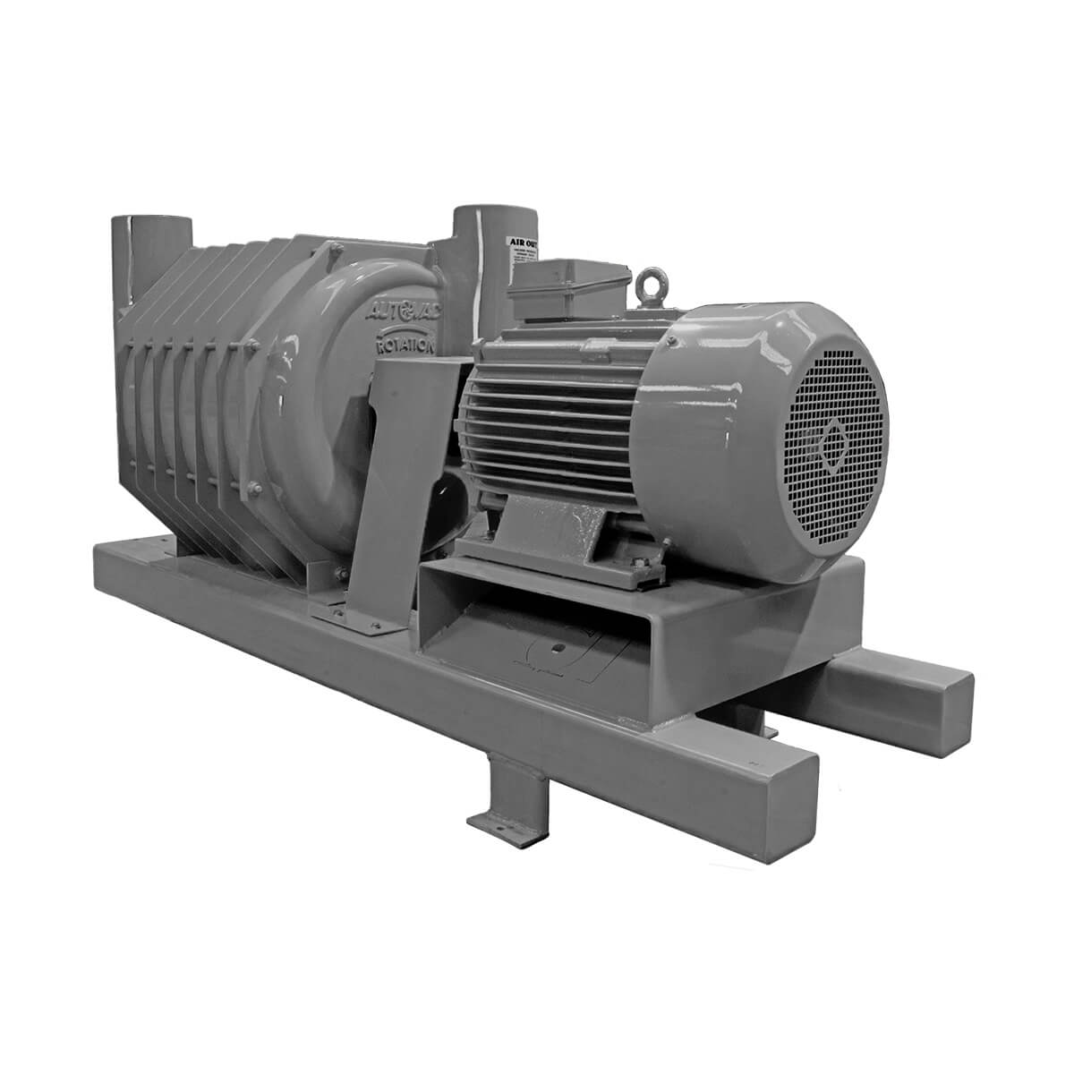
Vacuums
Brand Name
HP
RPM
Sub-Assets
Electric Motor
Coupler(E5,Lovejoy)
Flange Bearings
Transducer
Vacuum Control Box
Producer

Slide 38
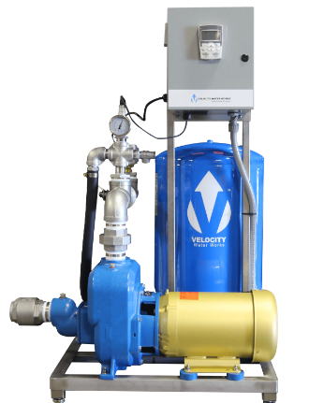
Repress Pump
Brand Name
HP
Sub-Assets
Electric Motor
Pump
Transducer
Pump Control Cabinet
VFD
Contactor
Check Valve
Bladder Tank

Slide 39
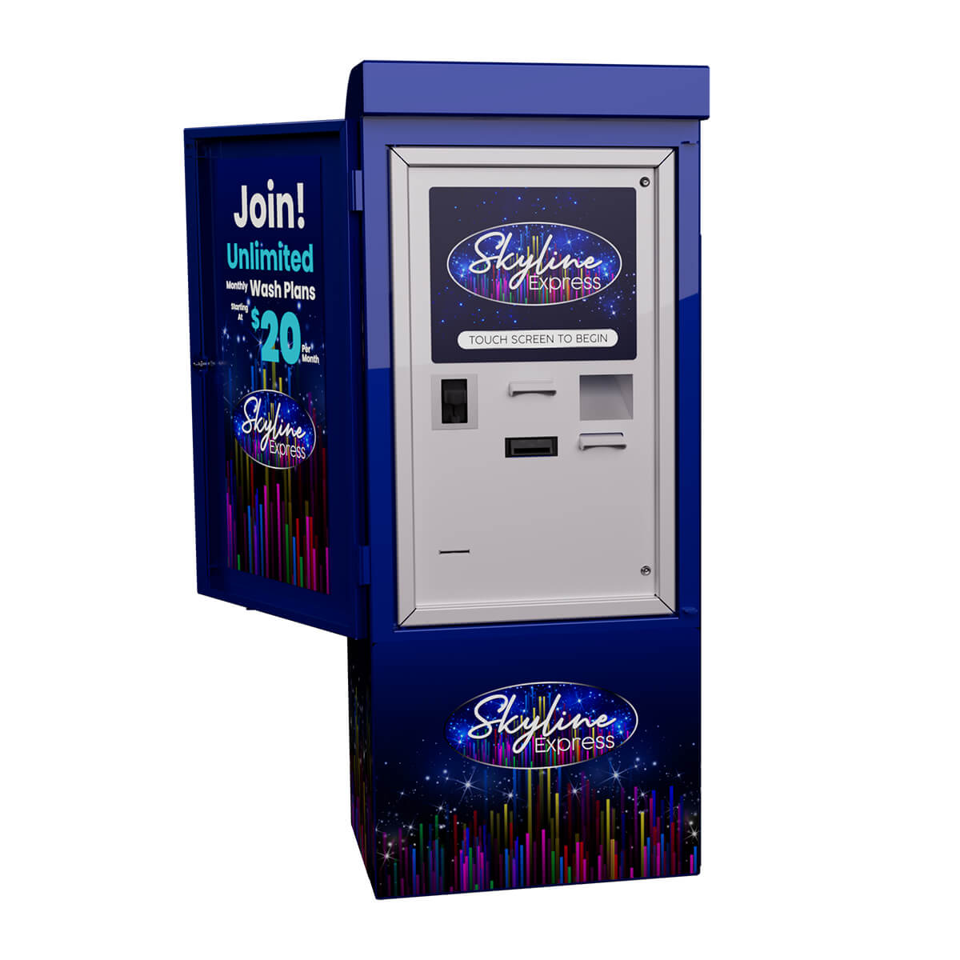
Pay Station
Brand Name
Sub-Assets
Touch Screen
Cash Validator
Credit Card Reader
Receipt Printer
Power Supply
Computer
Router

Slide 40
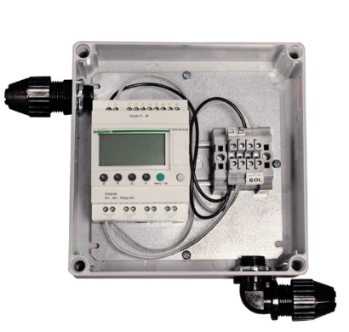
Tire Shine Control Panel
Brand Name

Slide 41
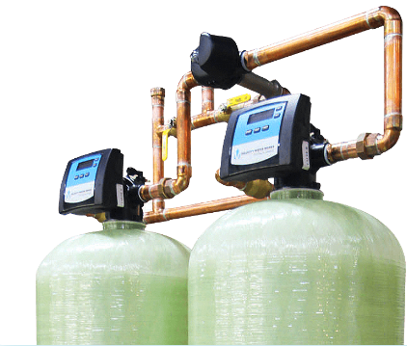
Water Softener
Brand Name

Slide 42
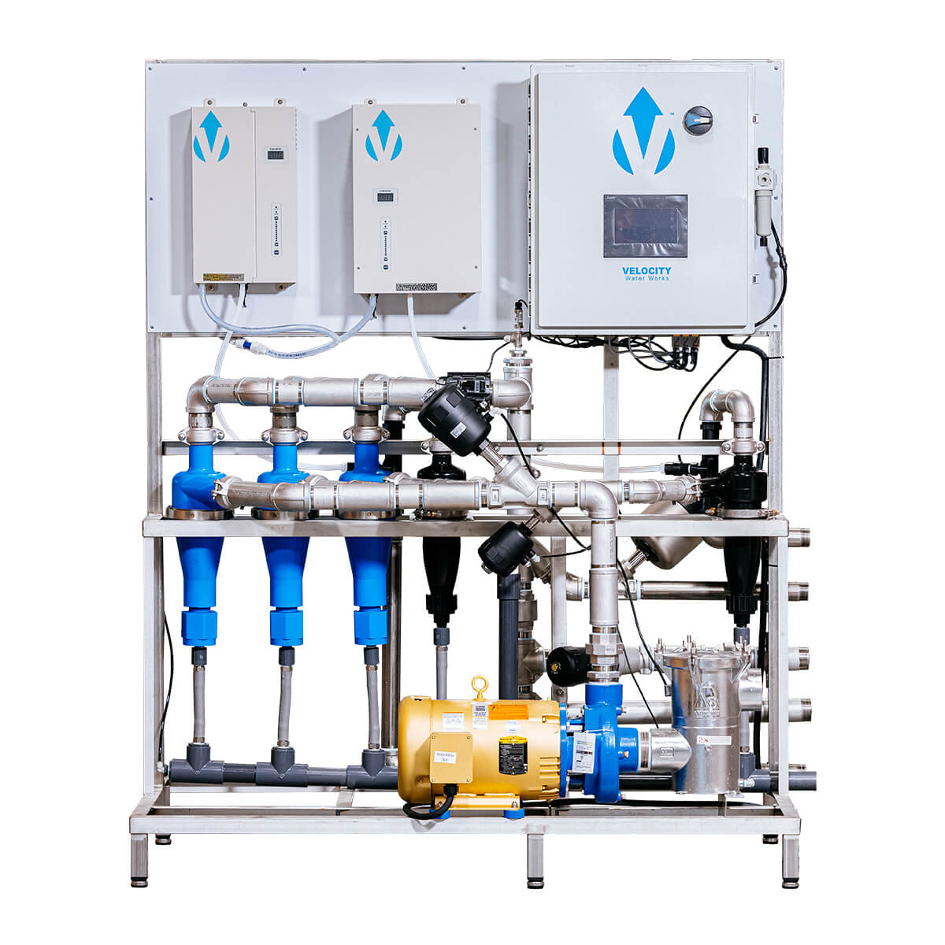
Reclaim
Brand Name
Sterilization

Slide 43
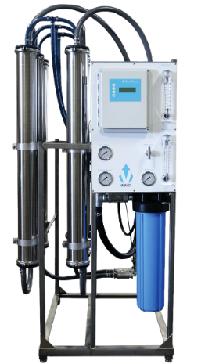
RO / Spot free
Brand Name
GPD

Slide 44
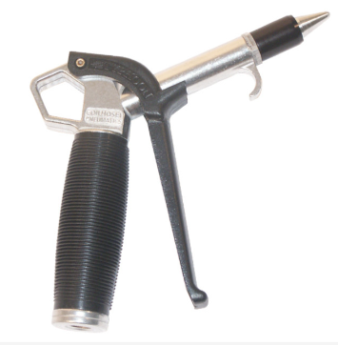
Detail Guns
Brand Name
Quantity

Slide 45
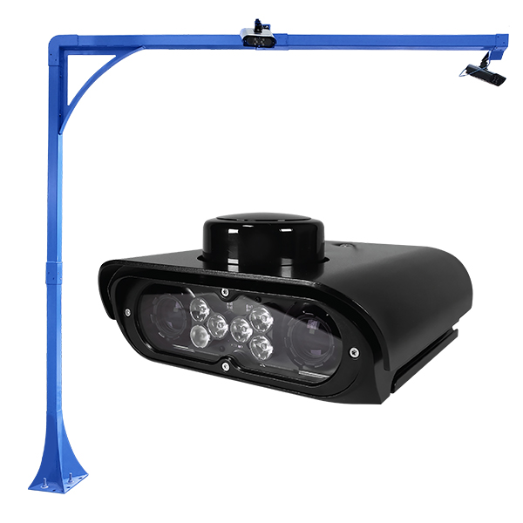
LPR
Brand Name

Slide 46
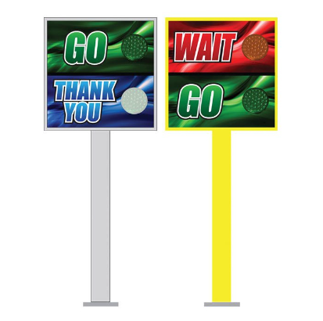
Stop & Go Light
Brand Name

Slide 47
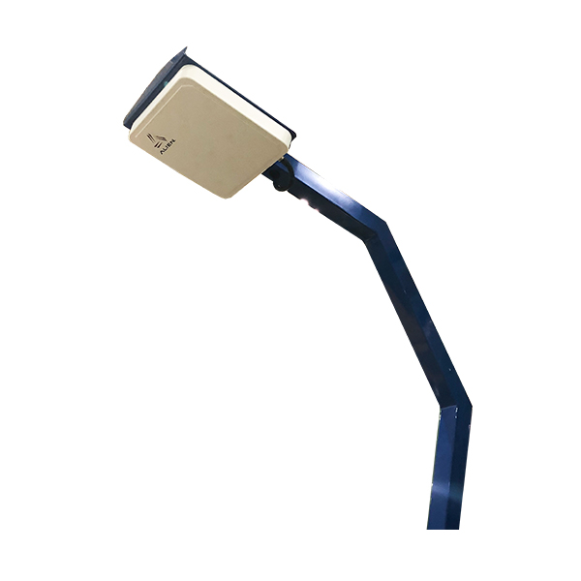
RFID
Brand Name

Slide 48
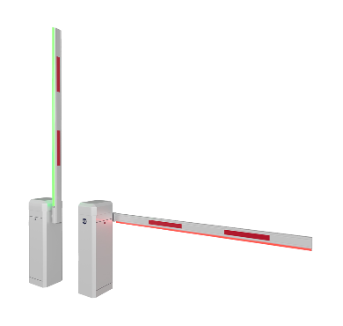
Gates
Brand Name

Slide 49
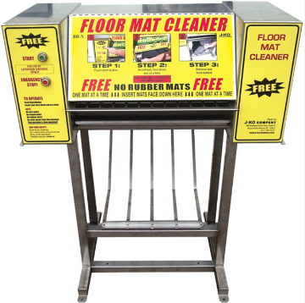
Mat Cleaners
Brand Name

